Slide 1
Week 7 Updates
Randy & Dylan

Slide 2
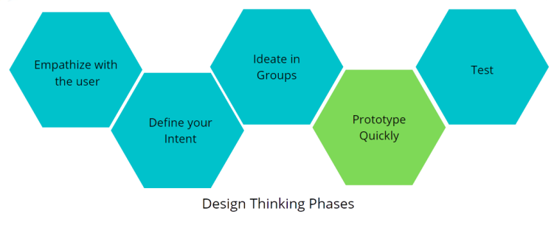
Phase 4: Prototype (Student Side)

Slide 3
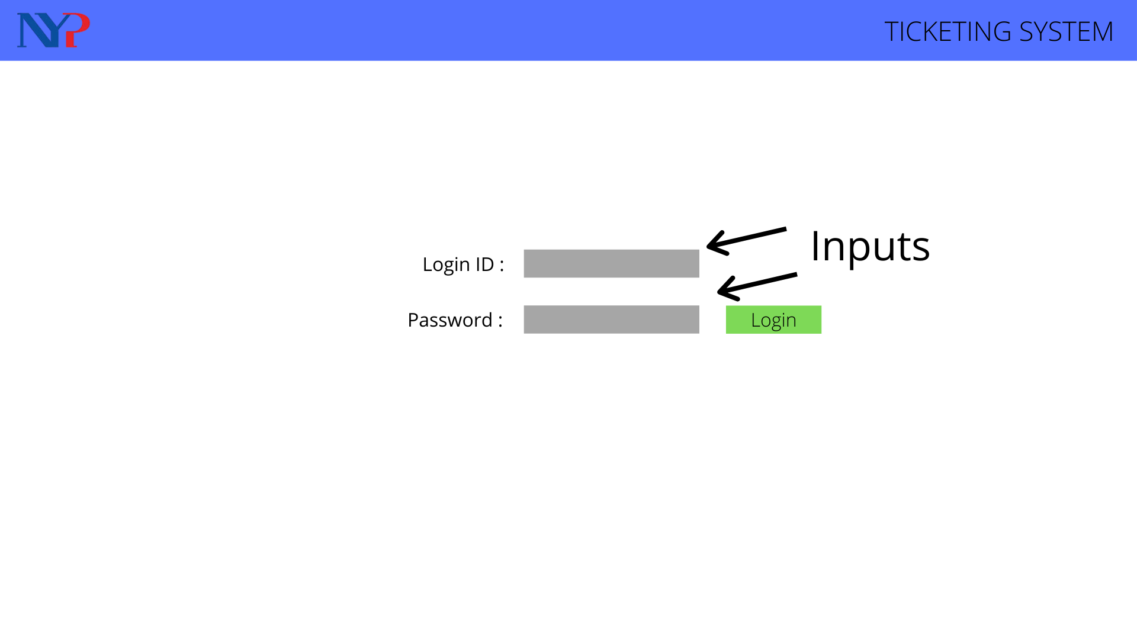
Login Page
Users are to enter their credentials in both input to sign in.

Slide 4
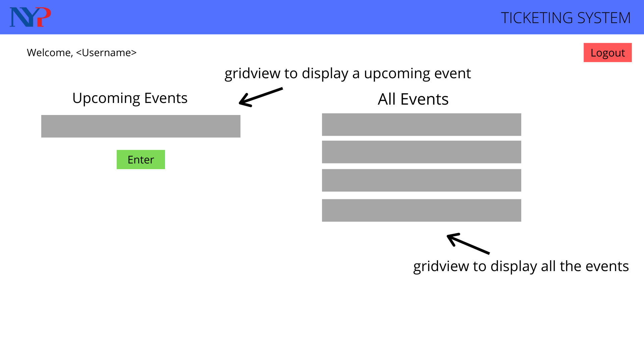
Student Dashboard
This is the dashboard the student will be seeing. To enter the event, users will have to click on the “Enter” button.

Slide 5
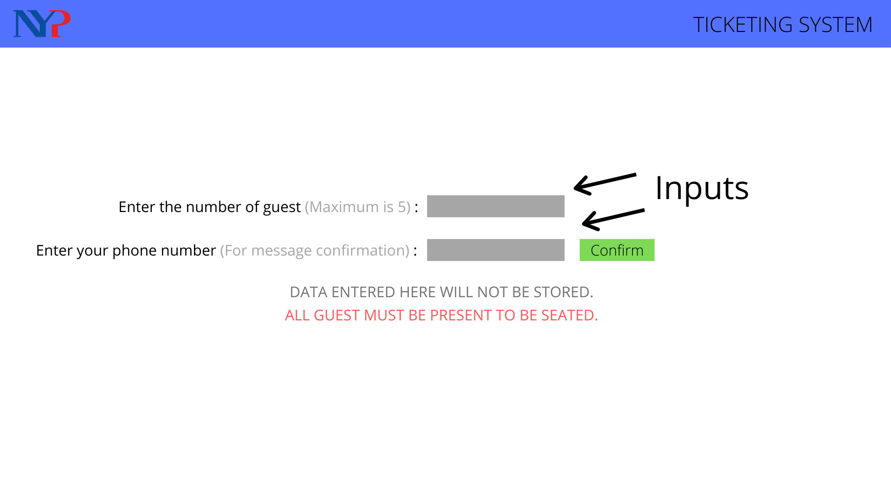
Input Guest Page
This is the page that will be shown after the students have clicked “Enter”. Guest on the event will be asked to key in the amount of guest they have as well as their phone number for message confirmation.

Slide 6
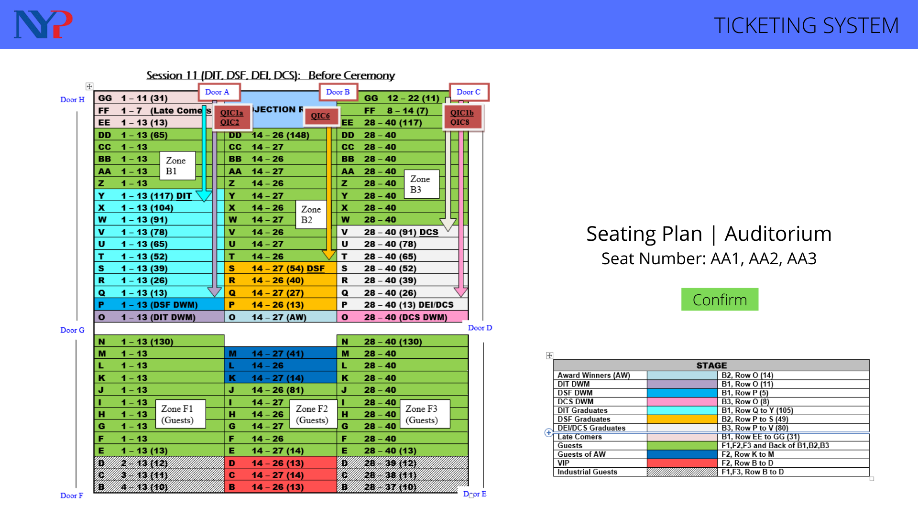
Seating Plan shown
The seating plan will then be shown after they confirmed.

Slide 7
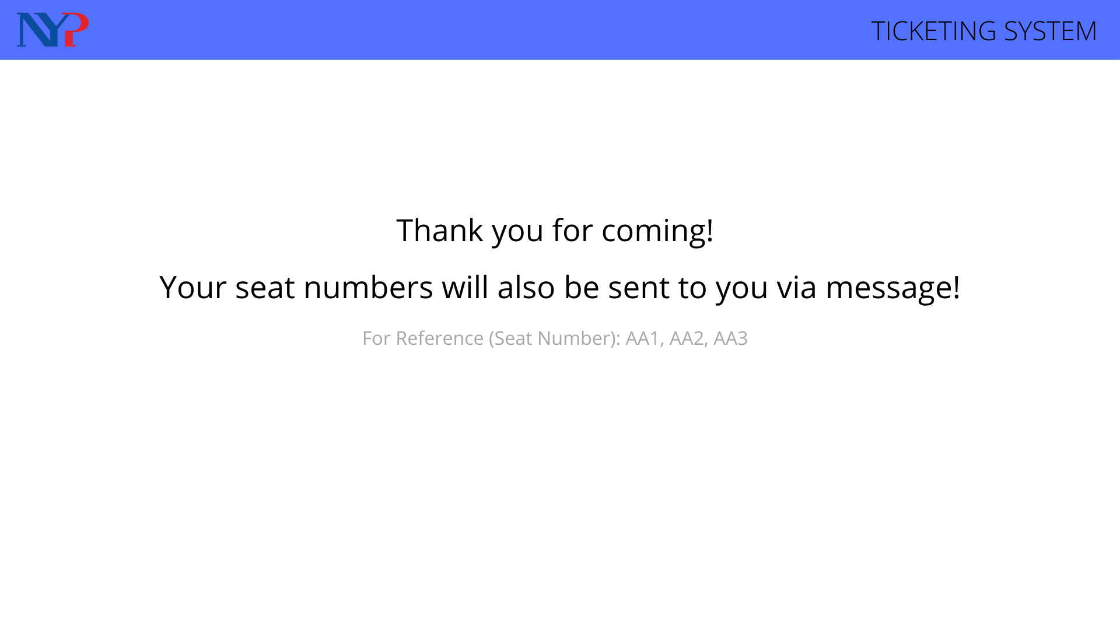
Thank you page
After clicking confirm on the previous page. Guest will be shown to this thank you page with the following text send to them.
Text message: Thank you for coming to the graduation ceremony!
Please note that you will only be seated when all guests arrive.
Your assigned seats are at AA1 AA2 and AA3.

Slide 8
Phase 4: Prototype (Planner)

Slide 9
Login Page
Users are to enter their credentials in both input to sign in.

Slide 10
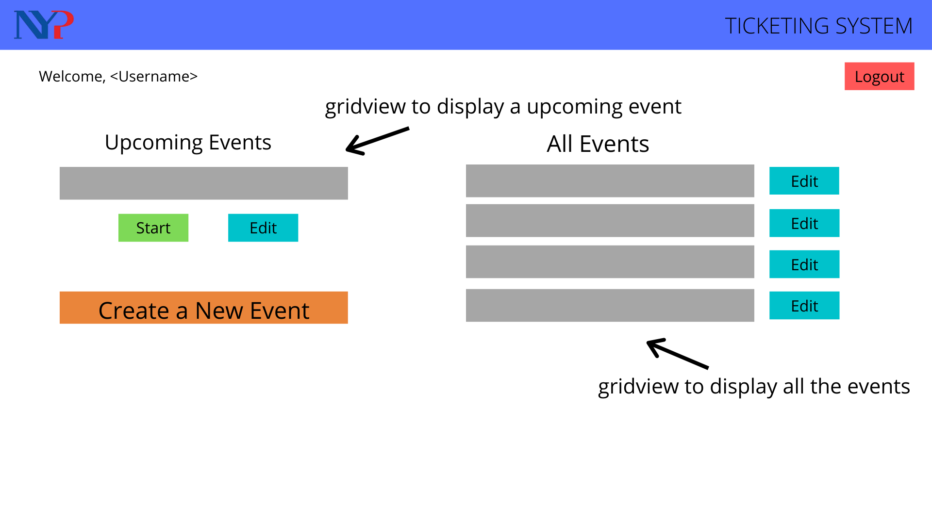
Planner Dashboard
This is the planner’s dashboard that shows the upcoming events, all events and create a new event.
Upon clicking on “Create a New Event”

Slide 11
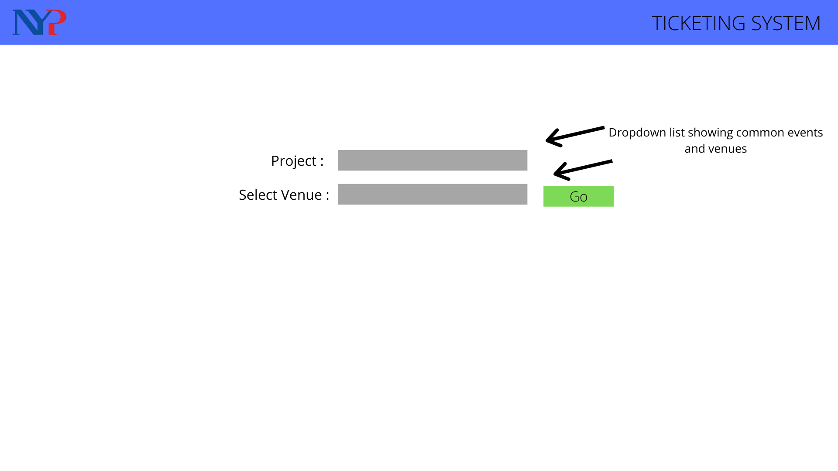
Creating new event
Planner will be redirected to this page where both dropdown list will be the common events and venues.

Slide 12
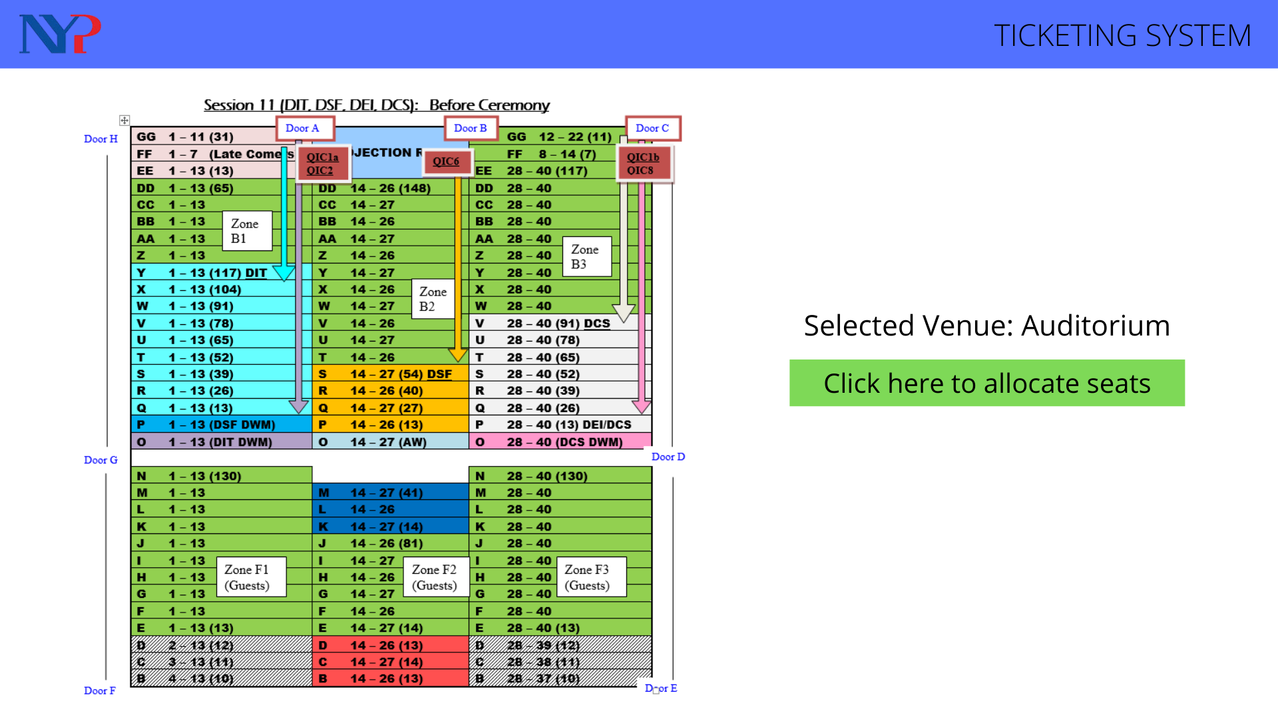
Seating Plan
Seating plans will be shown upon pressing “Go” on the previous page.

Slide 13
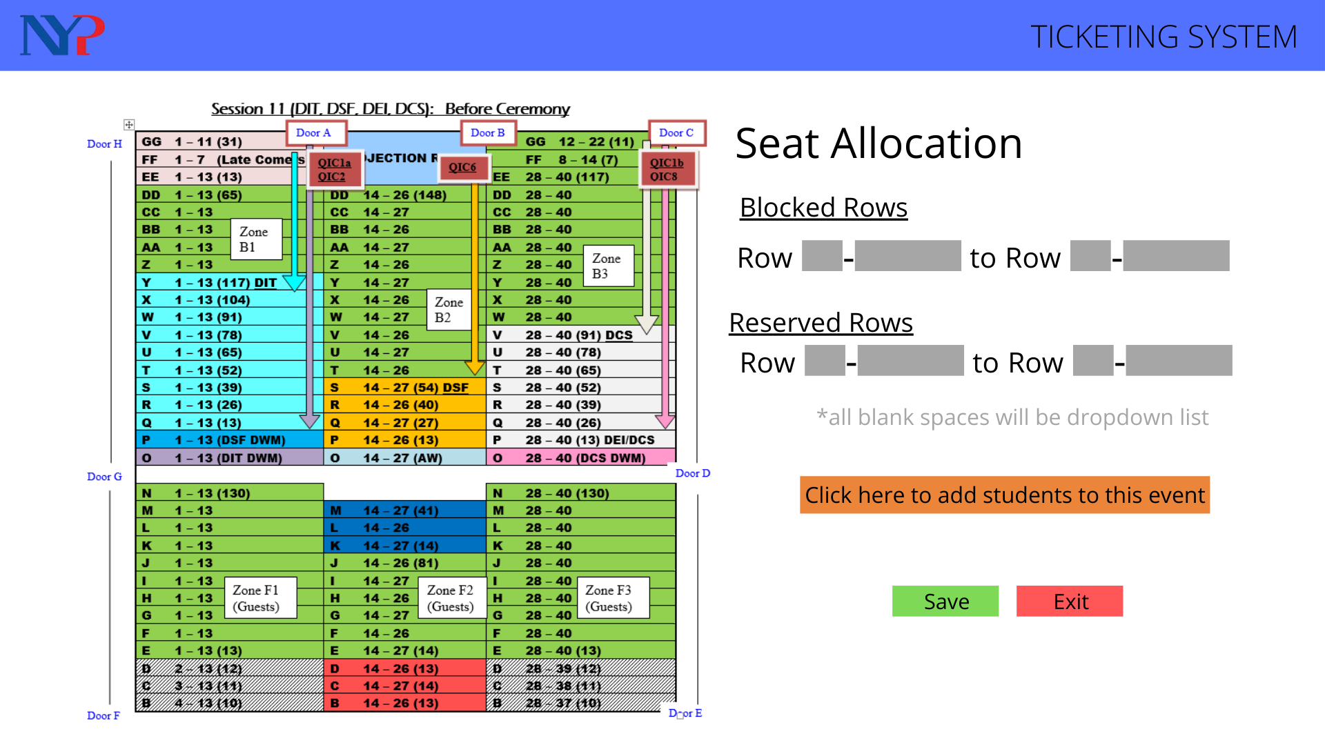
Allocating Seats
Clicking on the “Click here to allocate seats”. Planners will be redirected to this page, where they are able to reserve and block of seats.
Notes:
9362 2998

Slide 14
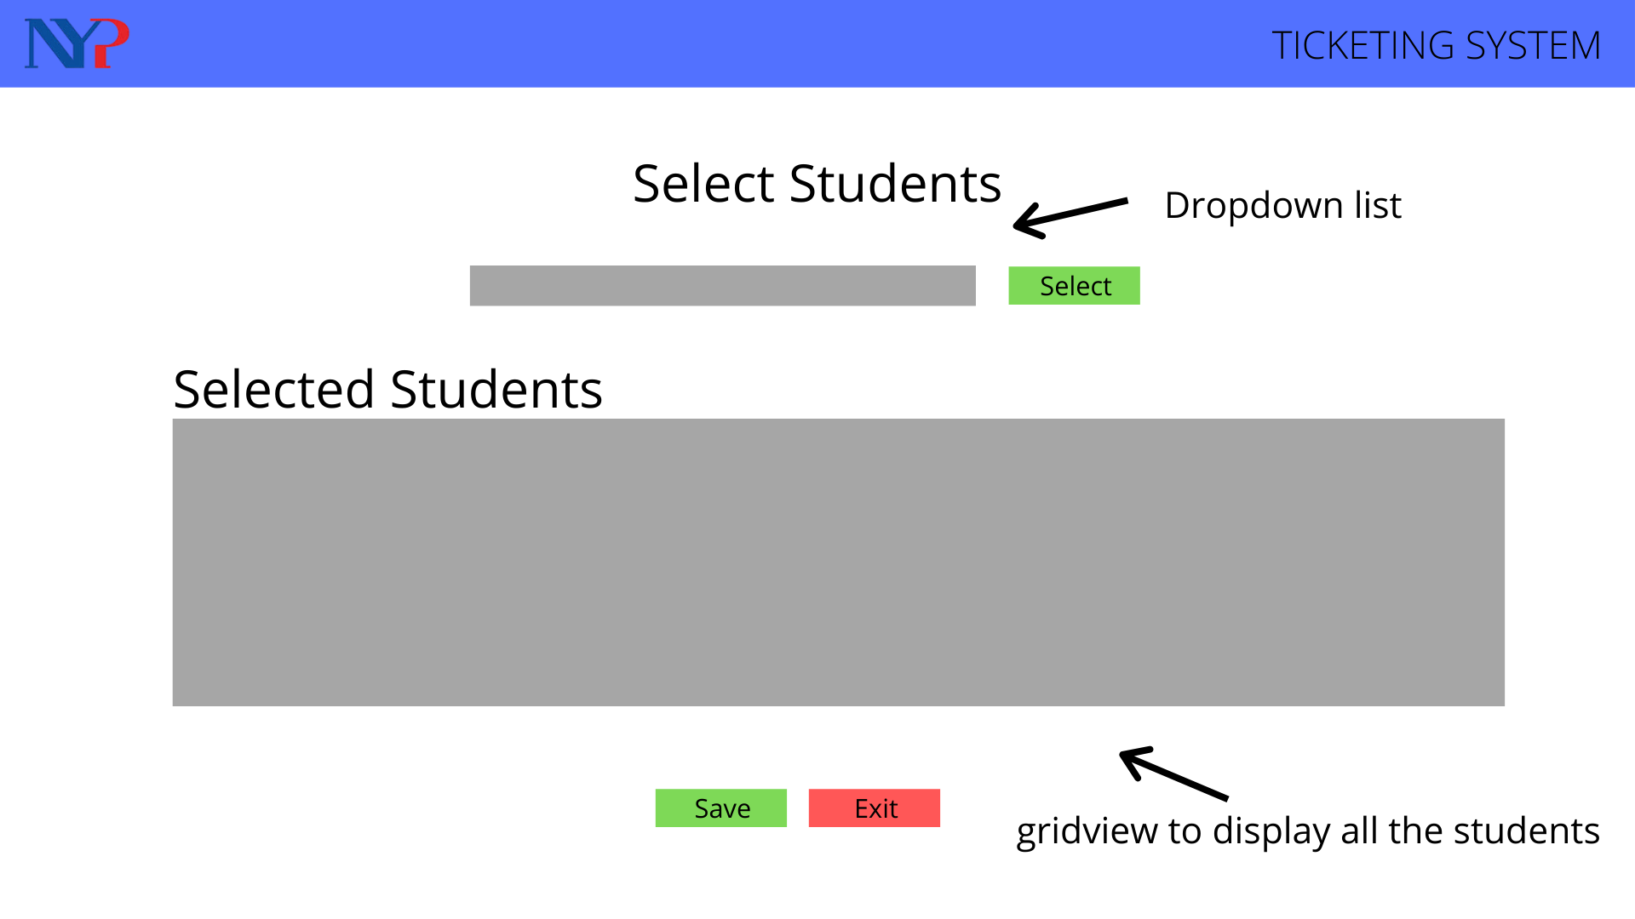
Selecting Students
This page allows planners to add students to the event.

Slide 15
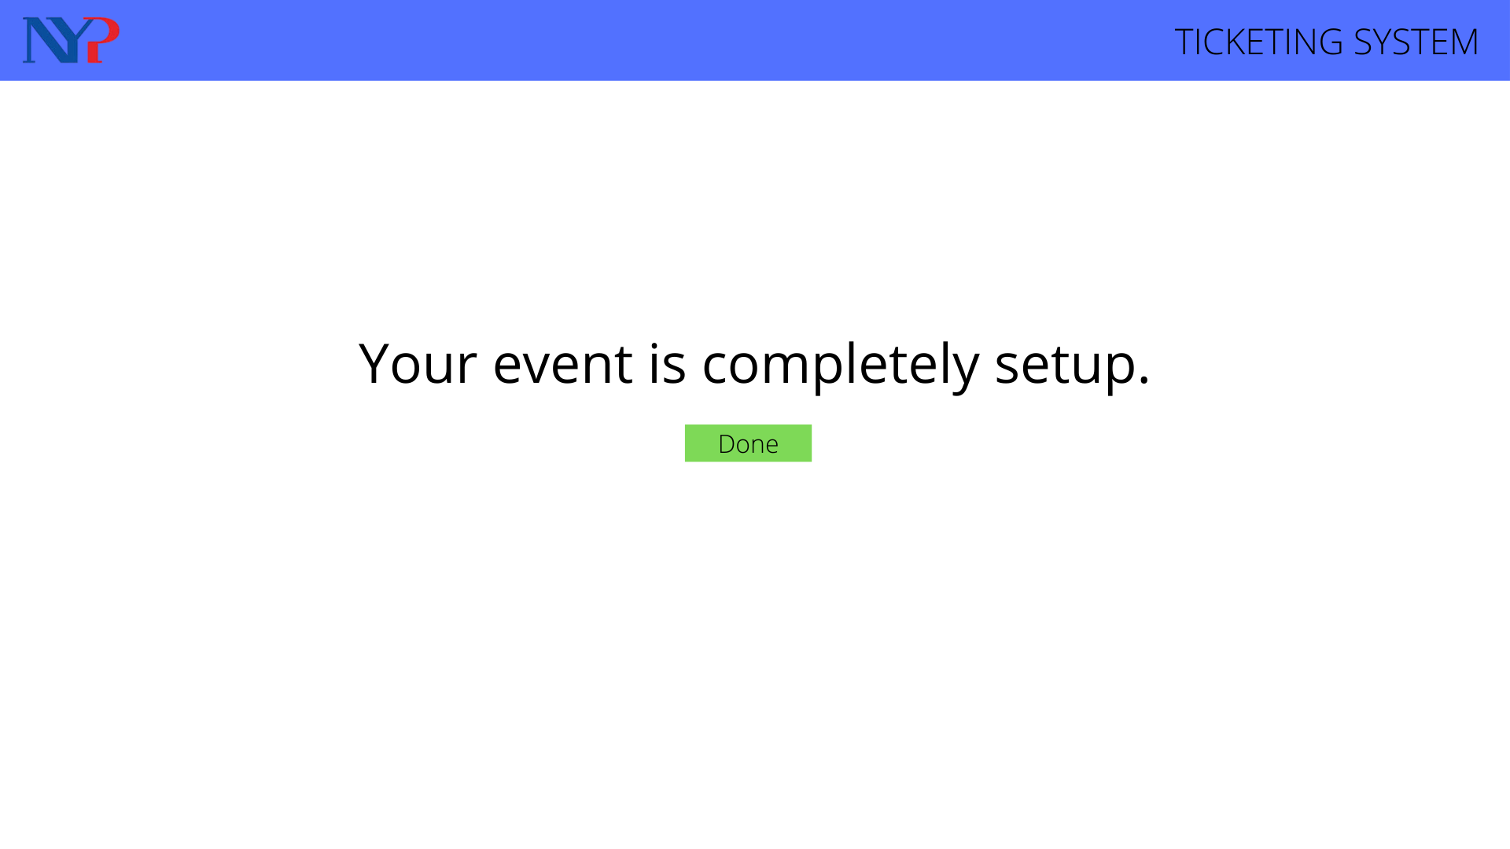
Confirmation Page
This page is a confirmation page that shows that the event is ready and confirmed.

Slide 16
The End.

